Slide 1
EARTHSHOTS 2023

Slide 2
Choose an earthshot

Slide 3
Choose an earthshot

Slide 4
Protect and restore nature

Slide 5
Clean our Air

Slide 6
Revive our Oceans

Slide 7
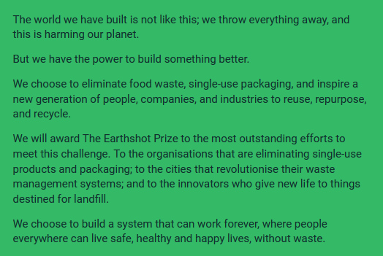
Build a waste free world

Slide 8
Fix our Climate

